Slide 1
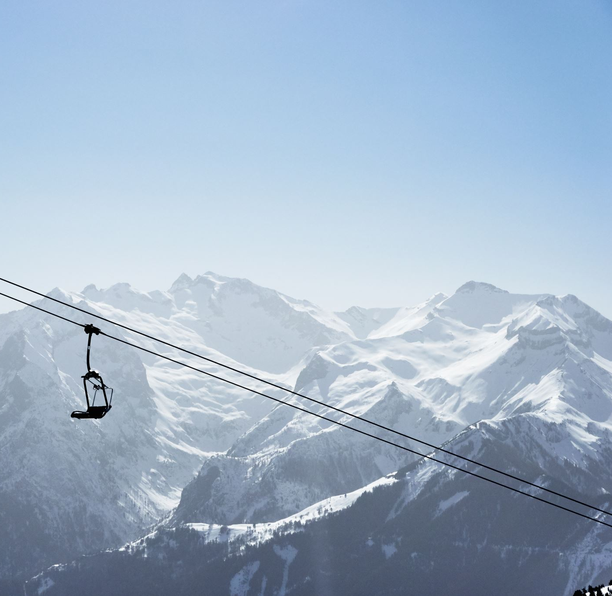
Big Mountain Resort
A Study of Ticket Prices

Slide 2
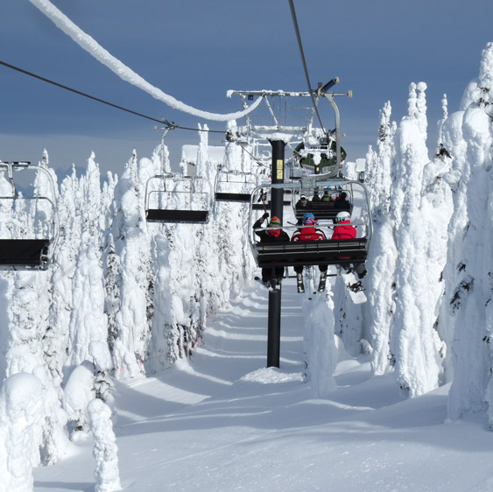
Potential for Profit
A large, popular resort, with 350,000 attendees every year
Current strategy has been to charge a premium based on average ticket price in the market
Can we connect the ticket price to the facilities offered at the resort?

Slide 3
Key Findings
The model suggests a ticket price increase of ~$10 is justified
Closing one run would have no expected effect on ticket price
Closing 5 runs would have the same effect as closing 3
Adding a new run and a chair lift to service it could justify a ticket price increase of $2.00
This represents a revenue increase of $3.5 million over a year

Slide 4
Data Cleaning and Exploratory Analysis
Weekend ticket price was chosen as the target feature
Some states were outliers in their number and kind of resorts
Further analysis found this was unlikely to cause issues
Resorts from all states and regions were treated as if they were in the same market
State based derived features were created
E.g. resorts per 100k sq miles

Slide 5
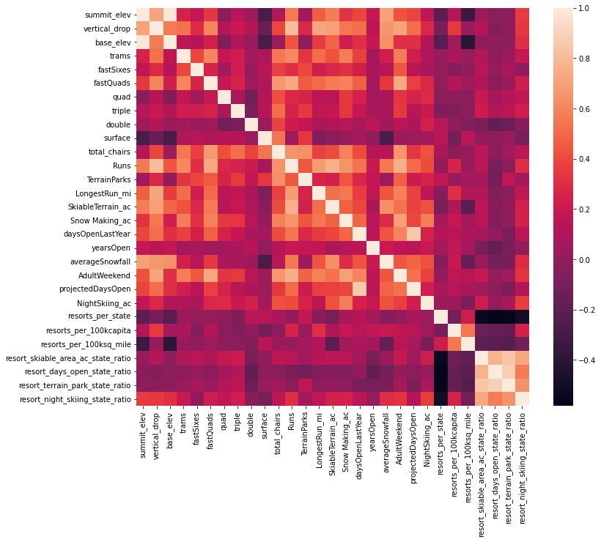
Correlation Matrix of all Features

Slide 6
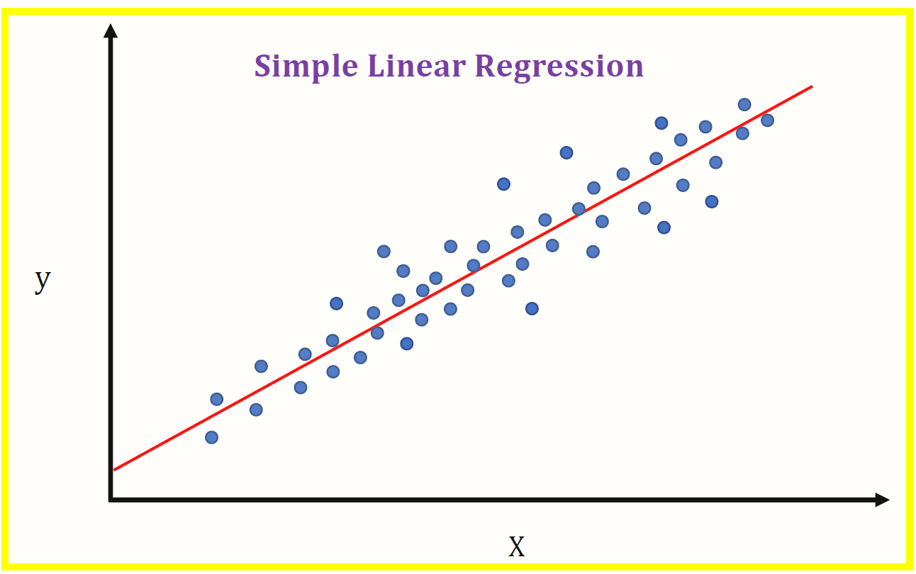
Training and Modeling
Baseline “DummyRegressor” model
Predicts the mean ticket price
Mean absolute error (MAE) of $19
Linear regression model
MAE of $10.50
Std. dev. of $1.6
Vertical drop and snow making capability were found to be most important features

Slide 7
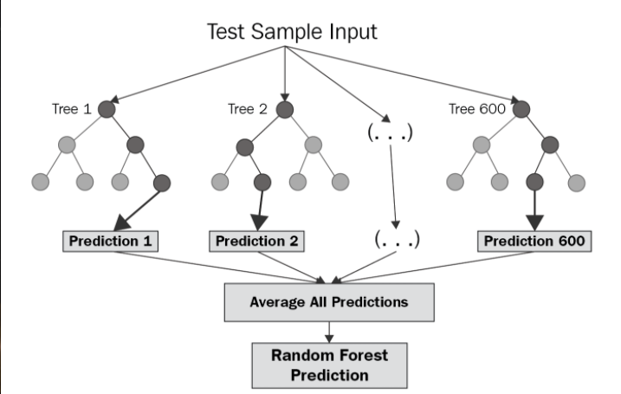
Training and Modeling
Random Forest Regressor
MAE of $9.60
Std. dev. Of $1.35
Chosen as the model going forward

Slide 8
Conclusion
A ticket price increase of $10 may be justified
Additional profit increasing measures such as closing 1-5 runs or adding an additional run with chair lift service are supported
More data on costs, both for Big Mountain or other resorts if possible would improve the accuracy of the findings

